Slide 1
Airline Route Forecasting for Australian Airways
University of Chicago
Time Series – Final Presentation
4th June, 2021

Slide 2
Contents
Executive Summary
3
5
Our Work Approach
10
Key Takeaways

Slide 3



Executive Summary > Introduction
Executive Summary
Our team consisted of interesting individuals with diverse cultures, across different continents, and different time zones …
Our Work Approach
Name - Olivia Fenwick
Industry – Travel
Experience – 4yr
Email – ofenwick@uchicago.edu
Key Takeaways
Questions
England
United States
of America
Name - Todd Livergood
Industry – Insurance
Experience – 21yrs
Email – livergood@uchicago.edu
Nigeria
Name - Oluwafemi Fabiyi
Industry – Big4 Consulting
Experience – 11yrs
Email – fabiyio@uchicago.edu
Notes:
Our goal was to determine where our airline can best leverage marketing to maximise revenue in 2022 by identify routes which have the most similar demand
We aim to do that by forecasting 2022 demand then using the forecasted demand to identify clusters
Pandemic greatly affected passenger demand but we don't anticipate this being accurate for 2022 and onwards so we will remove that outlier data
Original data goes back to 1984 but we think recent trends will be the most relevant to our problem
Use data from 2000 - 2019 to forecast 2022

Slide 4
Executive Summary > Problem Statement & Project Assumptions
Executive Summary
The problem of inefficient cost allocation, has the impact of not optimizing potential revenue for Australia Airways. So, a good starting point would be to identify routes with similar demand patterns, in order to effectively optimize marketing dollar spending.
Our Work Approach
Key Takeaways
Questions
1
2020-2021 are unprecedented years that will not reflect future demand so those years will be discounted
2
Anticipate that more recent data will be the most similar to future demand so data from 2000 – 2019 will be used
3
Aim to forecast 2022 demand and then cluster similar city pairs to find out where marketing dollars should be targeted

Slide 5





Our Work Approach > Our Journey So Far
Executive Summary
Our Work Approach
Plan
Design
Implement
Finalize
Our Journey So Far
Project Organization
Data Collection and Design Consideration
Core Analytics Task Execution
Showcase
Implementation
Methodology
Key Takeaways
Explore data and inherent characteristics / relationships
Team Members Selection
Data Collection
Exploratory Data Analysis
Develop
Presentation
Slides
Questions
Project Topic Research and Selection
High level
Data Review
Through imputation fill in months with missing data with what we would have expected demand to be if the flight had flown
Discard routes that did not fly in 2019, decreased from 75 to 65 routes.
Data Processing
Project
Presentation
Project Brief Development
Design Considerations
Choose to use only 2000 – 2019 from the original time series
Feature
Engineering
Generate a forecast using multiple time series methods
and compare to find the best fit
Use 2000 – 2018 to train the data and 2019 to test the data
Modeling & Evaluation
Use the forecast to cluster similar routes
Result
Start
2 Weeks
2 Weeks
3 Weeks
2 Weeks
End
Completed
Completed
Completed
Where we are !
Notes:
Our team structured the delivery of this project across the following 4 project phases with the core Analytics task spread across the design and build phases

Slide 6
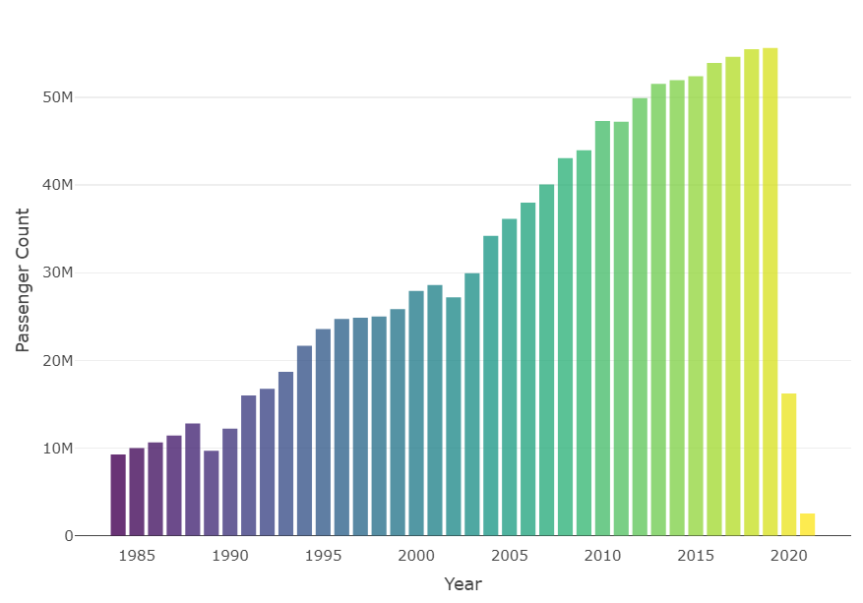
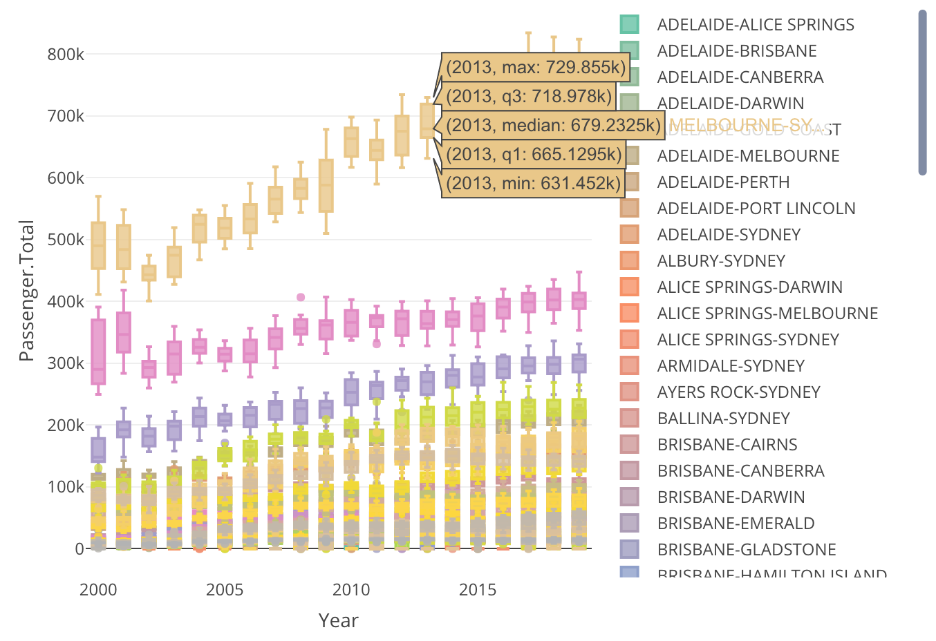
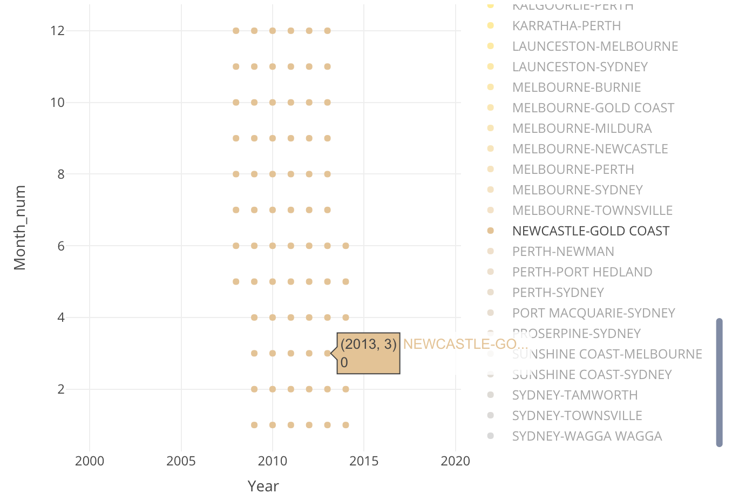
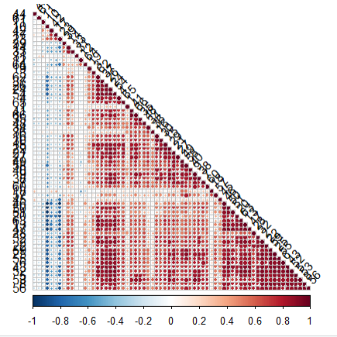
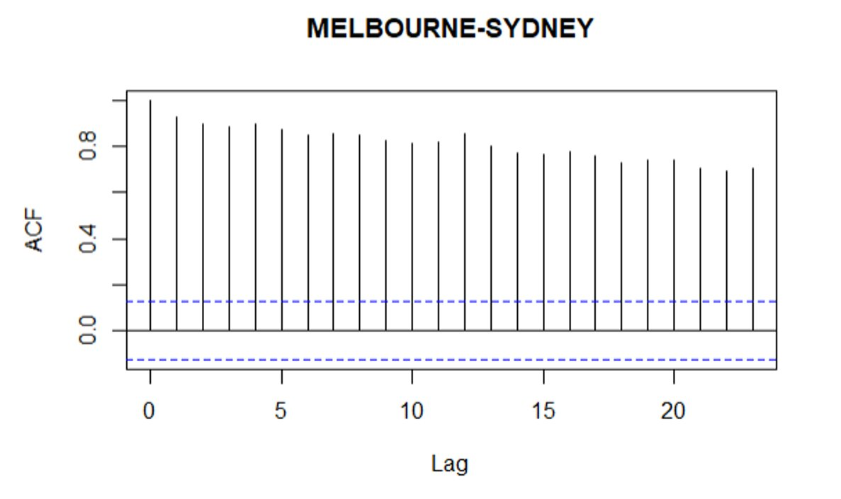
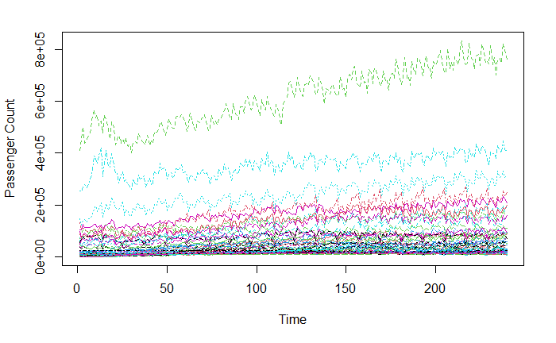
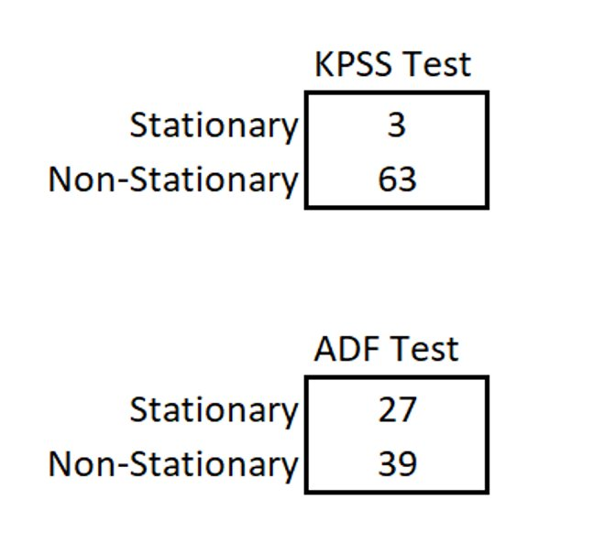
Our Work Approach > Methodology > Exploratory Data Analysis
Executive Summary
Total Passengers
Flight Routes Summary
Months Flown
Our Work Approach
Our Journey So Far
Methodology
Key Takeaways
Questions
Correlation Between Routes
Passenger Demand by Route
Stationarity Test

Slide 7
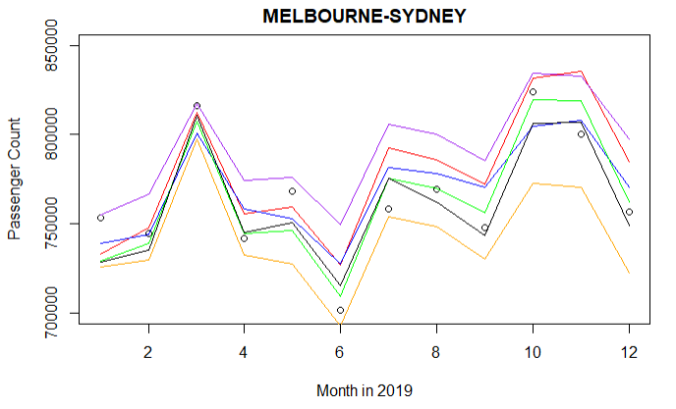
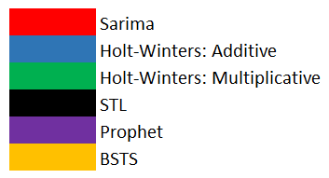
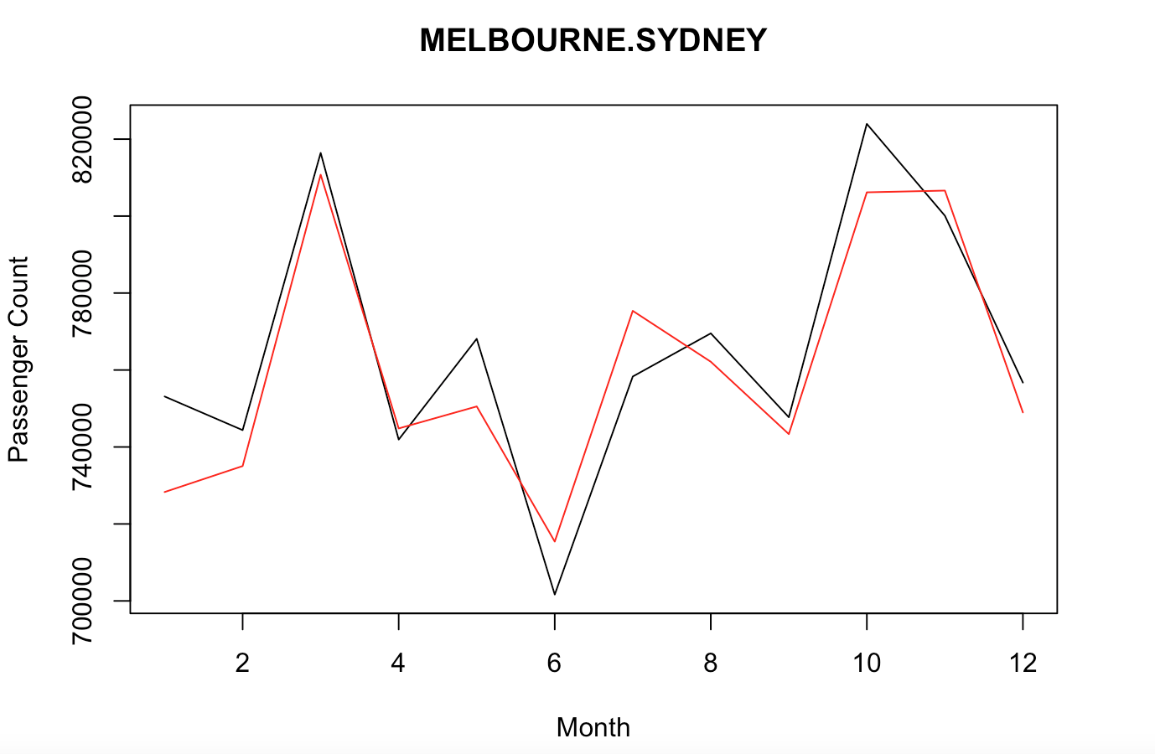

Our Work Approach > Methodology > Modeling
Executive Summary
Whilst all 65 routes were evaluated with each of the six different models, below is a highlighted view of one of the routes
Our Work Approach
Our Journey So Far
Methodology
Key Takeaways
Statistical Models
Sarima
Holt-Winters
Curve-Fitting Models
STL
Prophet
BSTS
Feature Engineering – Log
transformation for input into BSTS
model
Questions

Slide 8
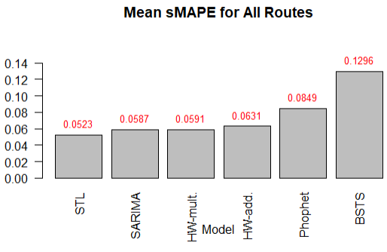
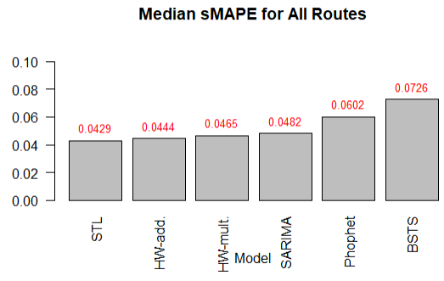
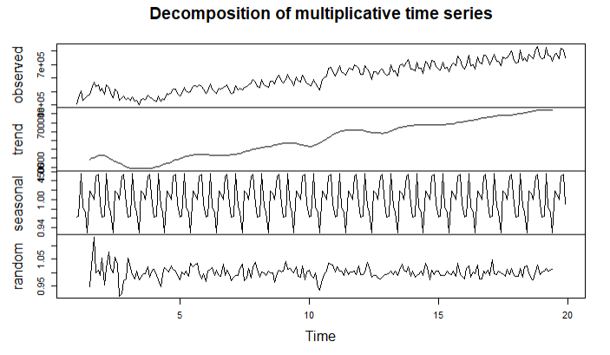
Our Work Approach > Methodology > Modeling Comparison
Executive Summary
sMAPE was the agreed metric for model comparison and the outcomes include:
Our Work Approach
Our Journey So Far
Methodology
Key Takeaways
Questions
STL is model of choice!
Lowest sMAPE
Able to decompose models into seasonal, trend, and random components
Can handle non-stationary data

Slide 9
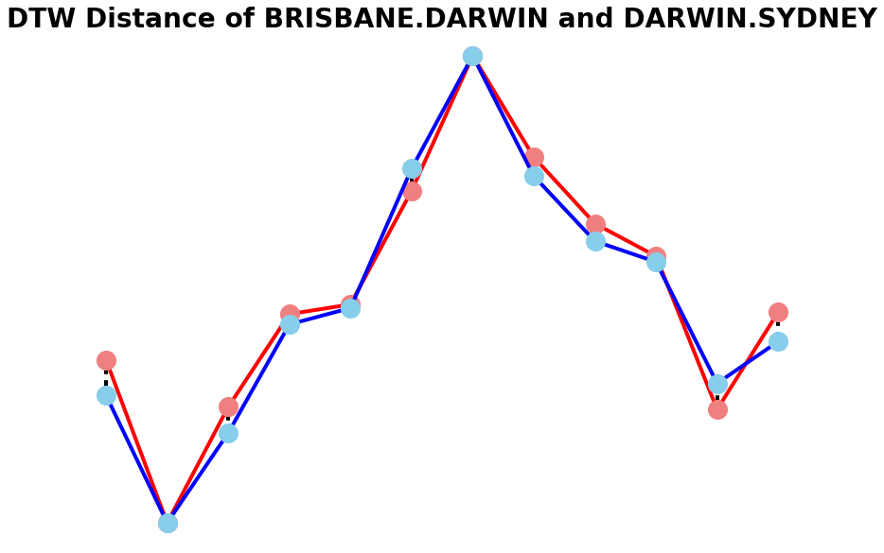
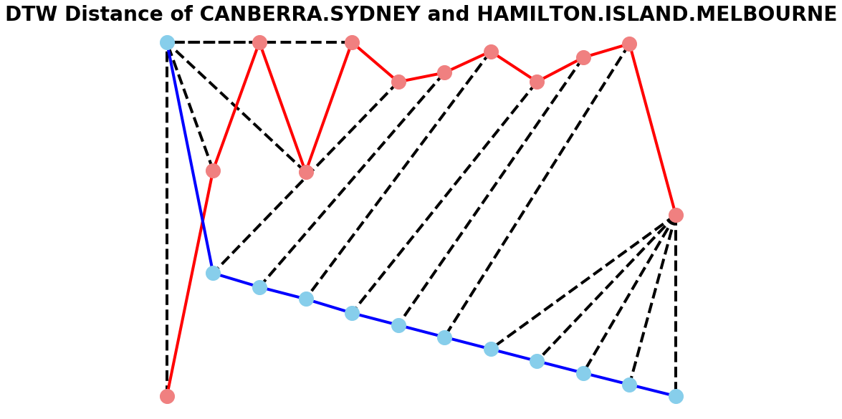
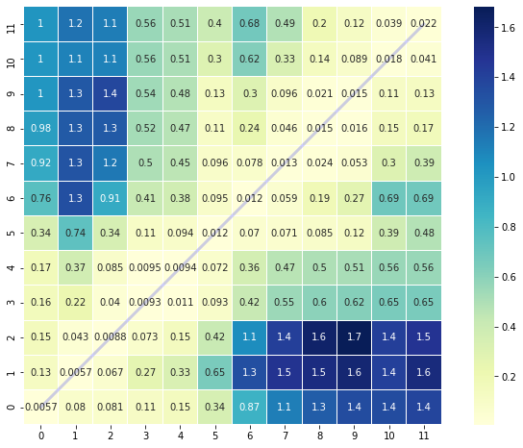
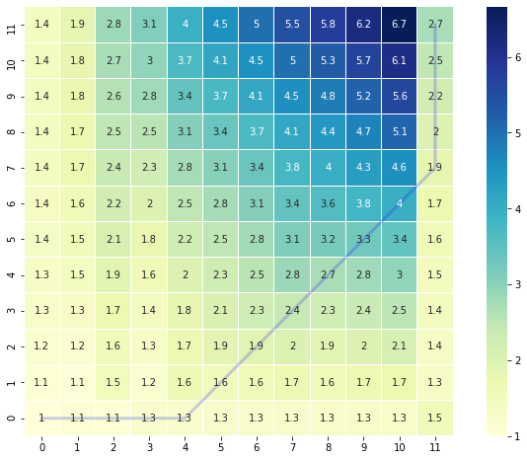
Our Work Approach > Methodology > Dynamic Time Warping
Executive Summary
DTW Distance Brisbane-Darwin and Darwin-Sydney
DTW Distance Canberra-Sydney and Hamilton Island-Melbourne
Our Work Approach
Used 2022 forecast generated by our STL model to calculate the DTW distance between routes
Routes with smaller DTW distance have more similar demand patterns
Created clusters of similar routes
Will use the clusters to make recommendations for where to target marketing dollars
Our Journey So Far
Methodology
Key Takeaways
Questions
Cost Matrix Brisbane-Darwin and Darwin-Sydney
Cost Matrix Canberra-Sydney and Hamilton Island-Melbourne
Notes:
Scaled data to make it more manageable
Compare a route to itself get a DTW distance of 0

Slide 10
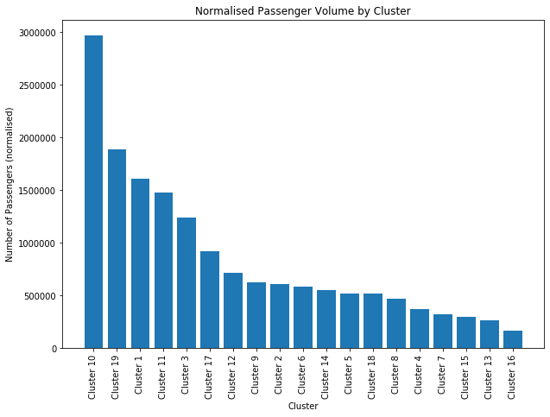
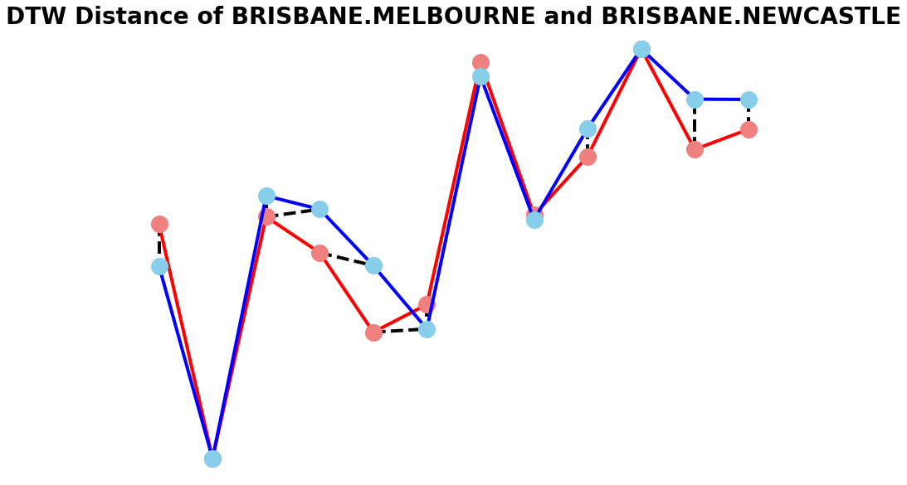
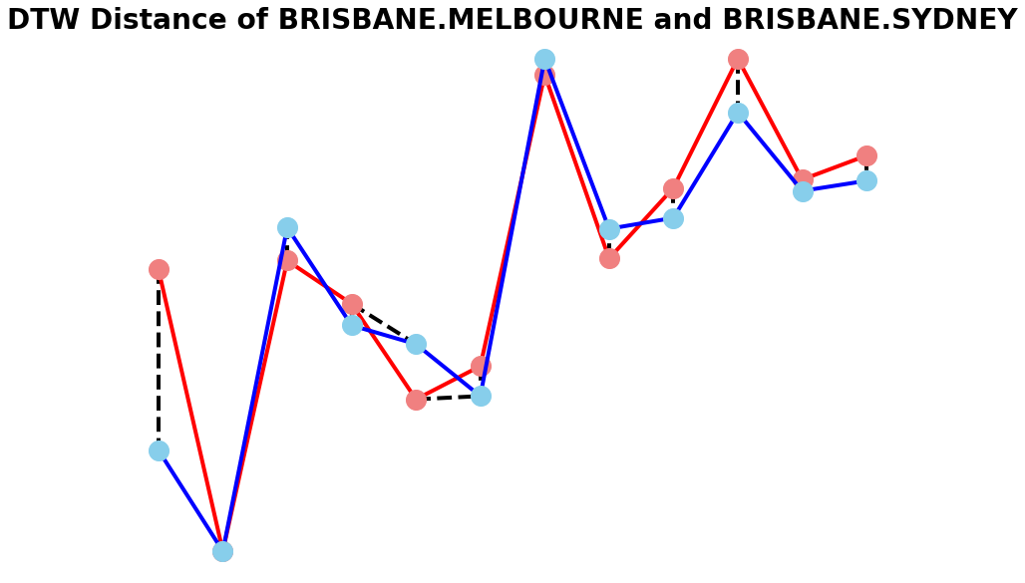
Key Takeaways > Results and Insights from Dynamic Time Warping
Executive Summary
Our Work Approach
There are 19 clusters with a DTW distance less than 1.0
To prioritise which clusters to focus on we compared the normalised passenger volume of each cluster
Cluster 10 had by far the largest volume of passengers and an average DTW distance of 0.77
It has three routes: Brisbane-Melbourne, Brisbane-Sydney, and Brisbane-Newcastle
Key Takeaways
Results and Insights
Future Recommendations
Questions
Cluster 10
Notes:
Normalised pax volume = (total number of pax in cluster)/(number of routes in cluster)

Slide 11
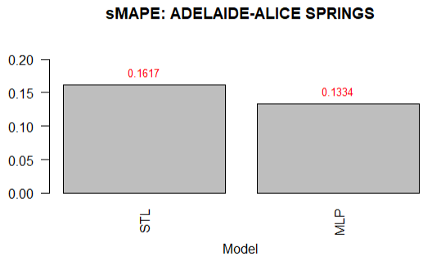
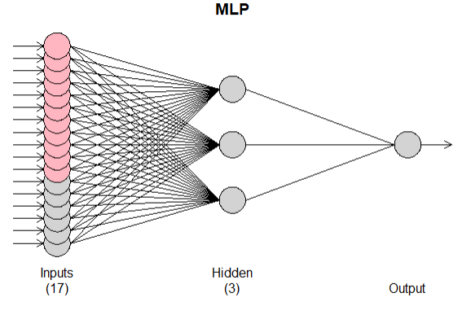
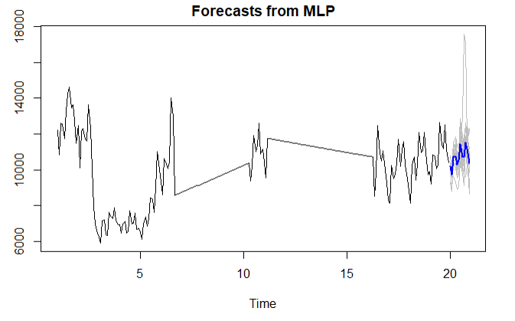
Key Takeaways > Future Recommendations
Executive Summary
We see an opportunity to improve model performance by leveraging deep learning
Our Work Approach
However, we observed longer training time for modeling all route compared to the selected route “Adelaide-Alice Springs”​
Considering time and computing resource constraints for initial delivery, we packed this as an initiative to further explore for improvement
Key Takeaways
Results and Insights
Future Recommendations
Questions
Notes:
Normalised pax volume = (total number of pax in cluster)/(number of routes in cluster)

Slide 12
Executive Summary
Our Work Approach
Key Takeaways
Questions
Questions

